Slide 1
PHAEOCHROMOCYTOMA ANAESTHETIC ISSUES AND MANAGEMENT
DR.N.SATHYAN

Slide 2
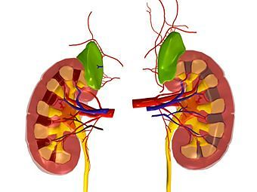
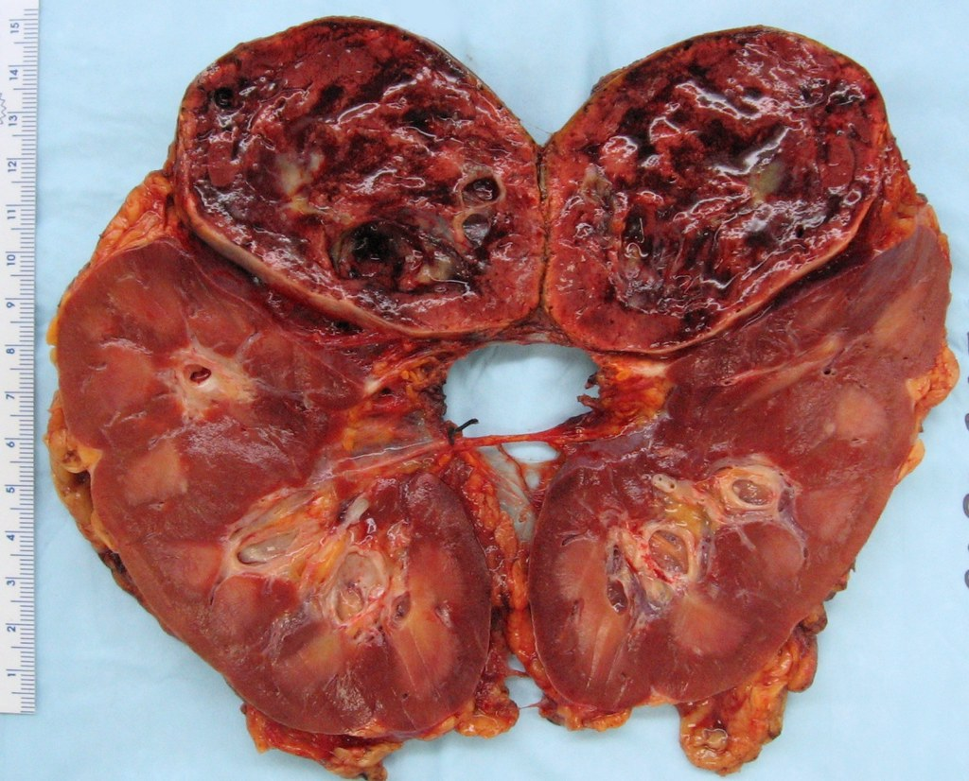
Objectives
Clinical Presentation
Diagnosis
Management

Slide 3
Introduction
Neuroendocrine Tumor of the Adrenal Medulla
Chromaffin cells along the paravertebral sympathetic chain
Phaeo – dusky ., chromo – coloured
History – Von Frankel, Pick, Roux & Mayo
Secretes excessive amounts of Adrenaline, Noradrenaline & Dopamine

Slide 4
ORIGIN

Slide 5
Tumors Producing Catecholamine Excess
Phaeochromocytoma
Sporadic ( Norepi > Epi ) vs Familial ( Epi > Nor)
Large (more metabolite) vs Small ( more catecholamines)
Paraganglioma - Norepi
Malignant Phaeo - Dopamine, HVA
Ganglioneuroma – Norepi
Neuroblastoma – Dopamine, HVA
Chemodectoma & Glomus jugulare - Norepi

Slide 6
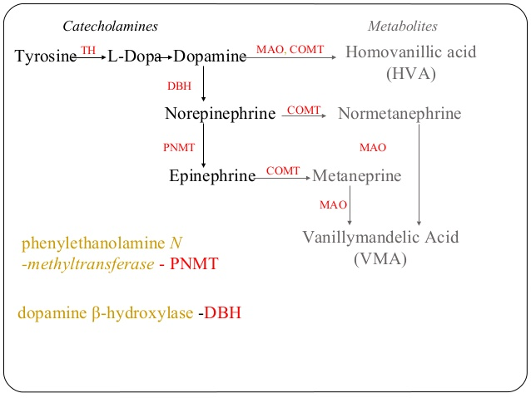
Metabolism

Slide 7
“RULE OF 10 “
EXTRA ADRENAL ( Close to 15 %)
CHILDREN
FAMILIAL ( 20%)
BILATERAL OR MULTIPLE (Familial)
RECUR (extra adrenal)
MALIGNANT
INCIDENTALOMA

Slide 8
Familial Phaeochromocytoma
MEN 2a
50% Pheo (usually bilateral)+ medullary Ca Thyroid +
hyperparathyroidism
MEN 2b
50% Pheo (usually bilatl) mucosal neuroma, marfanoid habitus
Von Hippel-Landau
50% Pheo (usually bilat), retinoblastoma, cerebellar hemangioma, nephroma, renal/pancreas cysts

Slide 9
Familial Phaeochromocytoma
NF1 (Von Recklinghausen's)
2% Pheo (50% if NF-1 and HTN)
Café-au-lait spots, neurofibroma, optic glioma
Familial paraganglioma
Familial pheo & islet cell tumor
Others:
1. Tuberous sclerosis,
2. Sturge-Weber,
3. Ataxia-telangectgasia,
4. Carney’s Triad (Pheo, Gastric Leiomyoma, Pulm chondroma)

Slide 10
Clinical Presentation
M = F ; 0.01% of HT ; 3rd -5th decade
Suspect : severe HTN, HTN crisis, refractory HTN,
young age HTN, incidental imaging
Symptoms : pain (headache) , perspiration, palpitation
Signs : Hypertension (pressures) , pallor
Paroxysms or episodic
10-60 min; daily – monthly ; spontaneous / precipitated (procedures, drugs, movements)

Slide 11
CVS Effects
Sinus tachycardia (epi), bradycardia (nor),SVT, Vent ectopics, VF
Systolic HTN, diastolic hypotension (epi)
Angina / MI / coronary vasospasm (catecholamine induced increased oxygen consumption)
Hypertrophic cardiomyopathy – diastolic dysfunction (nor)
Dilated cardiomyopathy – systolic dysfunction (epi)
Concentric / asymmetrical hypertrophy
Myocarditis – CCF
Polycythemia and orthostatic hypotension ( ecf contraction, loss of postural reflexes, release of adrenomedullin )
Sinus node dysfunction

Slide 12
CNS Effects
Panic attacks, apprehension, sense of impending doom
Hypertensive encephalopathy (altered mental status, focal signs, seizures)
Stroke , intracerebral bleed

Slide 13
Metabolic effects
Nausea & vomitting – dopamine induced GI vasodilatation
Glucose intolerance – dec insulin, glycogenolysis (nor),
Hypercalcemia – Men 2 HPT
Polyuria
Lipolysis - Weight loss

Slide 14
Diagnosis
Biochemical
Localization
24 hrs Ur. Catecholamine
24 hrs Ur. Tot metanephrines
24 hrs Ur. catechol + metanep
24 hrs Ur. VMA
HPLC ; Positive > 2-3 fold elev
Plasma free Catecholamine (>2000 pg/ml)
Plasma free Metanephrine
False Positive : drugs (tca,maoi,levodopa,methyldopa,labetalol,clonidine,illicit drugs,ethanol,diuretics,sympathomimetics); physical stress (hypoglycemia,stroke), smoking
Adrenal (90%) & extra adrenal sites (organ of zuckerkandl, bladder, myocardium, mediastinum)
CT Abdomen – adrenal pheo
MRI – extra adrenal phaeo
MIBG Scan
I 123/I 131 labelled
tumor not visible CT/MRI
Inject mibg & scan @ 24,48,72,hrs
False negative – labetalol,reserpine,tca,phenothiazines- w/h 4-6 weeks

Slide 15
Biochemical Tests : Summary
SENSITIVITY SPECIFICITY
U catechols 83% 88%
U total metanephrines 76% 94%
U catechols+metaneph 90% 98%
U VMA 63% 94%
Plasma catecholamines 85% 80%
Plasma metanephrines 99% 89%

Slide 16
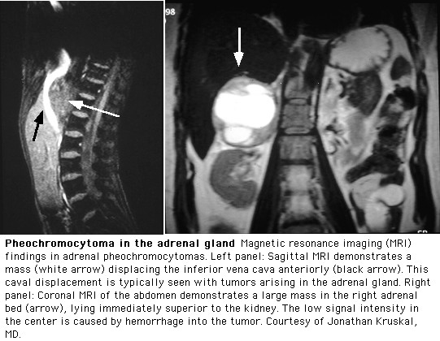

Slide 17
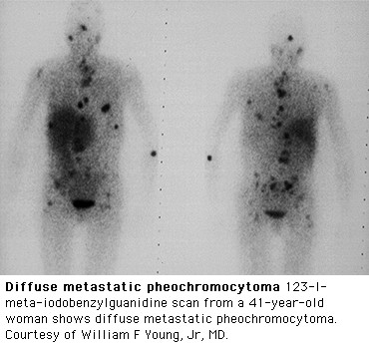
MIBG - SCAN

Slide 18
Suppression / Stimulation tests
Clonidine suppression test
Usually they decrease catecholamines
Unlike normals, pheo patients won’t suppress their plasma norepi with clonidine
Glucagon stimulation test
May precipitate hypertensive crisis
Pheo patients, but not normals, will have a > 3x increase in plasma norepi with glucagon

Slide 19
Anaesthetic Management
Mortality 25-50% vs 0-3%;
Preparation/newer techniques / team approach
Preoperative preparation
Intraoperative management
Post operative care

Slide 20
Anaesthetic Consideration
Preoperative optimisation
Alpha & Beta blockade
Restore intravascular volume
Haemodynamic lability and crisis
End organ Dysfunction
Associated conditions
Postoperative complications

Slide 21
Preparation Regimes
Combined α and β blockade (start 10-14 days preop)
Phenoxybenzamine
Selective α1 blockers (prazosin, doxazosin, terrazosin)
Propranolol, atenolol, esmolol
Labetalol
Metyrosine
Calcium channel blockers
Nicardipine
Diltiazem
ACEI / ARB

Slide 22
Phenoxybenzamine
DOC / Covalently binds α-receptors (α1 > α2)
Start 10 mg po bid ; increase q2d by 10-20 mg/d
Increase until BP control and no more paroxysms
Maintenance 40-80 mg/d (some need > 200 mg/d)
Clinical indicator : nasal stuffiness, postural hypotension
Side-effect: orthostasis with dosage required to normalize seated BP, reflex tachycardia
Causes presynaptic inhibition of adrenergic control thus leading to increase in beta adrenergic outflow, Thus beta blockers needed to be given alongside
Drawback: periop hypotension/shock unlikely to respond to pressor agents.
Roizens criteria : Arterial BP < 160/95 mm Hg in the last 48 hrs prior to surgery,recommended to measure in stressful environment ; Mild orthostatic hypotension indicates optimal α adrenergic blockade but not < 80/45; ECG - free of ST changes for > 2 wks; Ventricular ectopic < 1 over 5 min

Slide 23
Beta Blockers
Start only after effective α -blockade (may ppt HTN)
Used to control reflex tachycardia and prophylaxis against arrhythmia during surgery
If suspect CHF/dilated CMY ; start low dose
Propranolol :
Start 40 mg po bid ; increase to control HR
Up to 480 mg/day in divided doses
IV 1-2 mg bolus
Side effects- may induce cardiac failure, bronchospasm
Oral bioavailability 25% (extensive 1st pass metabolism)
Atenolol - selective β1
Dose 50- 100 mg/d PO ; Max 300 mg/d; IV 2.5 to 10 mg/d
Esmolol – selective β1
for rapid intraop BP control ; Bolus IV 250-500 μ/kg/min; Infusion 25 to 250 μ/kg/min
Labetolol –mixed ɑ+β
Dose- 50- 200 mg/d PO ; IV 0.25 mg/kg ; Not used as a sole drug due to unpredictable control of BP

Slide 24
Alpha Blockers
If BP still not control despite α + β blockade, Add Prazosin to Phenoxybenzamine
Prazosin (Minipress)
competitive, selective α1 blockade
T1/2 : 2-3 Hrs; Dose : 1-5 mg PO BD; Side effects- postural hypotension reflex tachycardia;No β blockade required; Not routinely used as incomplete a-blockade; Used more for long-term Rx (inoperable or malignant pheo)
Other selective α1 blockers- terazosin, doxazocin

Slide 25
CCB
Diltiazem
60 - 120mg/d, max 360mg/d ; T1/2 : 3 to 5 hrs; Side effects - bradycardia, exacerbates cardiac failure
Nifedepine
30mg/d PO Max. 360mg/d; T1/2 : 1 to 2 hrs; Side effects- hypotension, peripheral edema
Nicardipine
Started po 24h to few weeks preop to cntrl BP and allow ECF restoration; After intubation IV Nicardipine gtt (start 2.5 ug/kg/min); IV Nicardipine adjusted to SBP ; Stopped prior to ligation of tumor venous drainage; Tachycardia Rx with concurrent IV esmolol
Advantage : decrease severity of vasospasm
periop hypotension may still respond to pressor agents as opposed to those patients who are completely alpha-blocked
No reflex tachycardia

Slide 26
Metyrosine
Synthetic inhibitor of Tyrosine Hydroxylase (TH)
Start 250 mg qid ; max 1 gm qid
S/E : sedation, extrapyramidal, diarrhoea, nausea, vomitting , anxiety, renal /gb stones, galactorrhea
Alone may insufficiently control BP and reported HTN crises during pheo operation
Restrict use to inoperable/malignant pheo or as adjunct to α + β blockade or other preop prep

Slide 27
Volume Expansion
Increased fluid intake : 2-3 L
Increase Salt intake : 5-10 Gm
IV Crystalloids / Colloids
Serial Haematocrit measurement
5 – 10 % fall in Hct

Slide 28
Investigations
CBC
Sugar, urea, creatinine, electrolytes
BT,CT,PT,INR,PTT
X-ray chest
Electrocardiogram
Echocardiogram

Slide 29
Premedications
Admit night before for overnight IV saline
Anxiolytic sedative- benzodiazepine helps dec catecholamines release
Opioids- morphine preferably avoided as causes histamine release; Fentanyl, sufentanyl safe
Atropine or Glyco pyrolate to be omitted- causes tachycardia
Droperidol- antiemetic, blocks alpha 2 adrenoceptor and inhibit catecholamine uptake & promotes catecholamine release

Slide 30
Check Availability
Meds given on morning of surgery
Periop HTN :
IV Phentolamine (Regitine) , short acting non-selective alpha-blocker
IV Nitroprusside (NTP) / IV Nitroglycerine
IV Esmolol / IV Labetalol
IV Magnesium Sulphate
Periop Arrhythmia: IV Esmolol
Inotropic Supports : Dobutamine / Milrinone
Periop Hypotension:
IV crystalloid +/- colloid
Dopamine / Norepinephrine / phenylephrine
vasopressin

Slide 31
Monitors & Lines
ECG, Saturation, NIBP, EtCO2, RR, Temp, Urine output
Arterial line
CVP
Pulmonary Artery catheter (low EF)
TEE
2 large bore IV peripheral lines

Slide 32
Anaesthesia Technique
General Anaesthesia
Combined General and Regional anaesthesia – GA + EPIDURAL preferred
Induction
Thiopentone /Propofol/Etomidate
BZD + Opioids + Induction agents
Pressor response attenuation
Laryngoscopy & Intubation catecholamine levels increase normal 200-2000 pg/ml vs phaeo 2000 – 20000 pg/ml
Xylocard : 1.5 mg/kg
Esmolol : 50-100 mcg /kg
Neuromuscular blockers
cardiostable & least histamine release
Vecuronium / rocuronium / cisatracurium
Suxa / atra /miva – avoided
Maintainance :
Isoflurane / sevoflurane

Slide 33
Problems
Large tumors/ increased duration of Sx / increased preop catecholamines
HTN crisis
Laryngoscopy, intubation, positioning, skin incision, peritoneal insufflation, surgical stimulation, tumor handling
IV NTP, Phentolamine, NTG, Esmolol, nicardipine
MgSO4 , 40 - 60 mg/kg bolus followed by 2gm/hr infusion
Sudden Hypotension
Ligation of the venous drainage
Crystalloid / colloids, CVP 12
Dopamine/ Noradrenaline / Phenylephrine
Vasopressin / Methylene blue

Slide 34
Post OP
Hypovolemia
Hypertension
Hypoglycemia
Hyponatremia
Hypoadrenalism
ICU – care
Surveilance & Follow up

Slide 35
Laparoscopic Sx
Adrenal mass < 6 cms dia
< 100 gms weight
Slow CO2 insufflation
Pressure < 12 mm Hg
Positioning

Slide 36
Unresectable, Malignant
α-blockade
Selective a1-blockers (Prazosin, Terazosin, Doxazosin) 1stline as less side-effects
Phenoxybenzamine: more complete alpha blockade
Β -blocker
CCB, ACE-I, etc.
Nuclear Medicine Rx:
Hi dose 131I-MIBG or 111indium-octreotide depending on MIBG scan or octreoscan pick-up
Sensitize tumor with Carboplatin + 5-FU

Slide 37
Phaeochromocytoma in Pregnancy
Grave prognosis , mortality: maternal - 48%, fetal 55%
Diagnosis with 24h urine collections and MRI
No stimulation tests, no MIBG if pregnant
Do not Allow labour
1st & 2nd trimester (< 24 weeks):
Phenoxybenzamine + beta blocker prep
Resect tumor laprascopically or open
3rd trimester:
Phenoxybenzamine + βblocker prep…..2-3 wks
When 37 weeks: caesarian section followed by tumor resection

Slide 38
Conclusion
Good pre op preparation
Vigilant intra op monitoring
Intense post op care
Experienced coordinated Team

Slide 39
THANK YOU

